Slide 1
Part Ⅰ．Money and Finance 第1部 貨幣と金融
Chapter 1．Market Economy, Money and Finance
第1章 市場経済と貨幣、金融
Naotsugu HAYASHI 林 直嗣
Professor of Economics 経済学教授
Faculty of Business Administration 経営学部
Hosei University 法政大学

Slide 2
１．Development of Exchange Economy 交換経済の発達
Self-Sufficient Economy（autarky） 自給自足経済
＝an economy where we and our family obtained and consume goods by ourselves
私たちが自分の家族・同族と共に獲得した財を消費する経済
Direct Exchange Economy （= barter） 直接交換経済
＝an economic system where we directly exchange to each other different goods that we obtained through the division of labor
私たちが労働の分業を通じて得た異なる財を直接に交換する経済システム
Market 市場
＝the place where we exchange a good for another good (or money) to each other
私たちがある財を別の財（または貨幣）と交換する場所

Slide 3
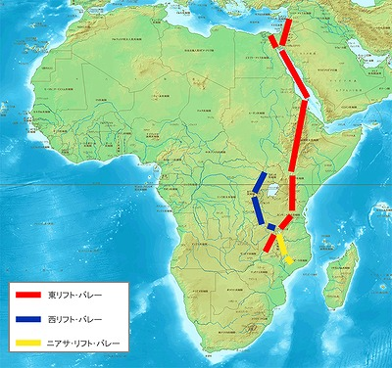
１-B．Development of Exchange Economy 交換経済の発達
The Birth of the Mankind 人類の誕生
A Great Rift Valley rose near the mountain Kilimanjaro in Africa 10～5 million years ago. The wet wind from the east ocean hit the mountain and brought rain in the east part, and there became a wet climate. Dry and hot wind came over a mountain, and deserts were made in the west part. It is called Foehn phenomenon. Because there were less food,
monkeys walked upright and used
the both hands in order to get food.
The intelligence developed because they
used both hands and came to use the tool.
This is birth of the mankind. The biggest
difference between monkeys and men is
the use of tools.

Slide 4
２．Emergence of Money 貨幣の出現
Conditions for Achieving Direct Exchange 直接交換を達成するための条件
＝Double Coincidence of Wants 欲望の二重一致
①Someone wants a good that I made, and I must want a good that he made. 私が作った財を欲しいという誰かがいて、誰かが作った財を私が欲しなければならない
②Something that I want must have the same value as other thing that he wants. 私が欲しい財と彼が欲しい別の財が同じ価値を持たなければならない
⇒Possibility for direct exchange is limited 直接交換の可能性は限られている
⇒Emergence of Money 貨幣の出現
Someone wants to exchange good 1 that he holds for good 2 that another has. ある人が持っている財1を別の人が持っている財2と交換したいと思う
But another one does not wants good 1. しかし別の人は財1を欲しくない
In such a case, someone first exchanges good 1 for good 3 that everyone accepts to exchange for any good, and then he may well exchange good 3 for good 2 that he wants. その場合ある人は初めに財1を誰もがなんとでも交換してくれる財3と交換し、次の財3を彼が欲しい財2と交換すればよい
The good 3 that intermediates the exchange between good 1 and good 2＝Money
財1と財2の交換を仲介する財3＝貨幣
the nature of good 3 that everyone accepts to exchange for any good
誰もがどの財とでも交換を受容するという財3の性質
＝General Acceptability 一般的受容性

Slide 5
3. The Basic Natures of Money 貨幣の基本的性質
Basic Natures（besides General Acceptability）一般的受容性以外の基本的性質
①Divisibility 分割可能性
＝a nature of good that can be easily divided and can express the value of goods precisely
容易に分割ができて財の価値を正確に表現できる財の性質
Homogeneity 同質性
＝a nature of good that has the equal amount of value when it is divided
分割されたときに同量の価値を持つ財の性質
②Portability 携帯可能性
＝a nature of good that is convenient to carry and transport and that has relatively large value with light weight
携帯や運搬に便利で少量で、比較的に大きな価値を持つ財の性質
③Durability 耐久性
＝a nature of good that is hard to change in quality, depreciate and break down and that is durable
品質の変化や減耗、破損がしにくく、耐久性がある財の性質

Slide 6
4. Development of Money and Market Economy
貨幣と市場経済の発達
Commodity Money 物品貨幣= money that is used as daily good 日用品としても使われる貨幣
agricultural society…grains such as rice or wheat, farm tools
農業社会…米や小麦などの穀物、農具
fishing society…shell, born and horn 漁撈社会…貝殻、骨角器
hunting society…arrowhead, fur 狩猟社会…矢尻、毛皮
stock farming society…livestock, fur 牧畜社会…家畜、毛皮
Metallic Money 金属貨幣＝money made of iron, copper, bronze, silver, gold, or other metals that developed after refining methods are discovered 製錬技術が発明されてから発達した貨幣で、鉄、銅、青銅、銀、金などの金属からできた貨幣
Money by Weight 秤量貨幣＝metallic money that is exchanged after its quality is examined and its weight is measured 品位と量目が検査、計量された後に交換される金属貨幣

Slide 7

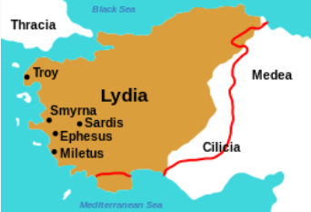


4. Development of Money and Market Economy(2)
貨幣と市場経済の発達（２）
Legal Tender 法定貨幣＝money issued by a state 国家により発行された貨幣
Stamped Money 刻印貨幣＝ metallic money that is stamped by a state and made with the same quality and weight 品位と量目が同じ金属片に国家が刻印をした金属貨幣
Lydia kingdom, around 650-600BC リディア王国 BC650-600
Electrum Money エレクトロン貨 ήλεκτρον（Ēlektron）＝amber 琥珀
(the pictures are cited from Wikipedia）
Athena around 6 century BC
アテネ BC6世紀
silver Drachme ドラクマ銀貨
Athena goddess on the face
表面はアテナ女神
Athena owl on the back 裏面はアテナ梟
(the pictures are cited from Wikipedia）

Slide 8
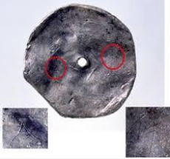
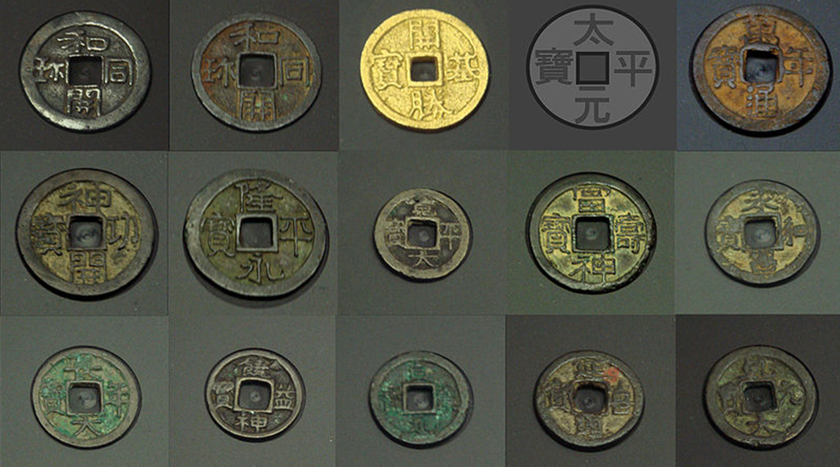
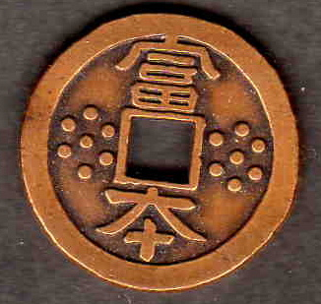
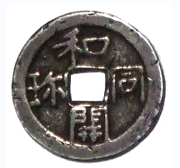
4. Development of Money and Market Economy(3)
貨幣と市場経済の発達（３）
No-stamped Silver Money 無印貨幣（鋳貨）＝the oldest metallic money 無紋銀銭 486AD
Coined Money (Coinage) 鋳造貨幣（鋳貨）＝money coined in metal with the same quality, weight and shape 品位と量目、形状が同じ金属で鋳造された貨幣
Coined Money (Coinage) in Japan 日本の鋳造貨幣
Fuhon-sen 富本銭 in 683 AD
Wado-Kaiho 和同開珎 in 708 AD
Kocho-12-sen 皇朝十二銭 in 708-958 AD

Slide 9
5．Monetary Unit and Prices
貨幣単位と価格
It is not convenient for people to determine the exchange
rate between money and goods after measuring the quantity and
quality of metallic money 金属貨幣の品位と量目を秤量してから貨幣と財の交換比率を決めることは不便
⇒The state Athena decided to call one unit of money as
one drachme アテネは1単位の貨幣を1ドラクマと呼んだ
＝monetary unit 貨幣単位
⇒all the exchange rates are now expressed simply as how many drachme すべての交換比率は単に何ドラクマと貨幣の個数で表される
price 価格＝the exchange rate expressed in monetary unit
貨幣単位で表示された交換比率
⇒to economize exchange information, to improve exchange efficiency
交換情報を節約し、交換効率を改善する

Slide 10
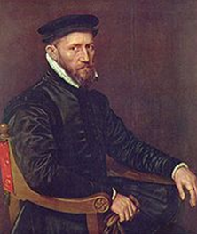
６．Gresham’s Law グレシャムの法則
As a market economy and monetary economy developed, the volume of
transactions increased and more and more money were required.
市場経済や貨幣経済が発達するにつれて、取引量が増大し、一層の貨幣が必要となった
⇒false money were made and circulated privately.
民間では偽金が製造され、流通した
⇒A state decided to monopoly the mintage right
国家は造幣権の独占を決定
⇒A state cannot help decreasing the amount of silver or gold contained in
metallic money and thus worsening the quality and quantity of metallic money in order to satisfy the increased demand for money
増大する貨幣需要を満たすため、国家は金属貨幣に
含まれる銀や金の量を減らし、品位と量目を悪化させ
ざるを得なかった
…“Bad money drives out good” …Gresham’s Law
悪貨は良貨を駆逐する…グレシャムの法則
Thomas Gresham, Royal financier for Elizabeth Ⅰ,
Royal Exchange, Gresham College

Slide 11
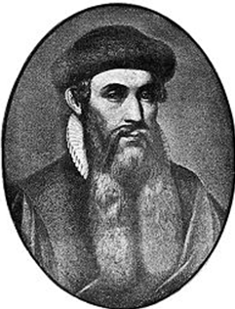
７．Development of Credit Money
信用貨幣の発達
Coined metallic money is inconvenient for the transactions of expensive amount, because too many pieces of money is required.高額の取引では金属貨幣は多量に必要なるので不便であった
As technology of paper making and printing by Gutenberg in1445 developed,
製紙技術や1445年にグーテンベルグによる印刷技術が開発されると
⇒Paper Money 紙幣
…the face value 額面価値＞the material value素材価値
nominal money or credit money
名目貨幣とか信用貨幣と呼ばれる
the face value – the material value
＝credit power of the state
額面価値－素材価値＝国家の信用力

Slide 12
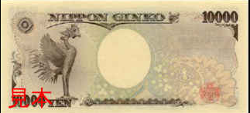
７B．Development of Credit Money
信用貨幣の発達
Convertible Paper Money System 兌換紙幣制度
＝to guarantee the exchange of paper money for
a certain amount of silver or gold money
（silver or gold reserves are required for exchange）
一定量の銀貨や金貨と紙幣を交換することを保証
（銀準備や金準備が必要）
NIPPON GINKO 日本銀行
Zipangu introduced by Marco Polo
Il Milione 百万長者・男1271-1295

Slide 13
８．Silver Standard, Gold Standard, Paper Money Standard
銀本位制、金本位制、紙幣本位制
Standard System 本位制度＝A monetary system that determines silver or gold money as a standard of monetary value 銀貨や金貨を貨幣価値の基準として定める制度
Convertible Paper Money System 兌換紙幣制度
＝It holds a certain amount of silver or gold reserves and guarantee for people to exchange paper money for these silver or gold reserves.一定量の銀準備や金準備を保有し、これらと紙幣を交換することを保証する制度
International Gold Standard System 国際金本位制
＝To maintain the proportion of net amount of gold contained in the monetary units of the two countries: the Gold Parity
２国の貨幣単位に含まれる金の純量の比率（金平価）を維持する制度
⇒tend to take precedence international equilibrium over domestic equilibrium
国内均衡より国際均衡を優先しがちとなる
⇒almost all the advanced countries abandoned the system after the world war 2
第2次世界大戦後は米国を除くすべての先進諸国が離脱した
⇒Paper Money Standard or Managed Currency System
紙幣本位制、管理通貨制度

Slide 14
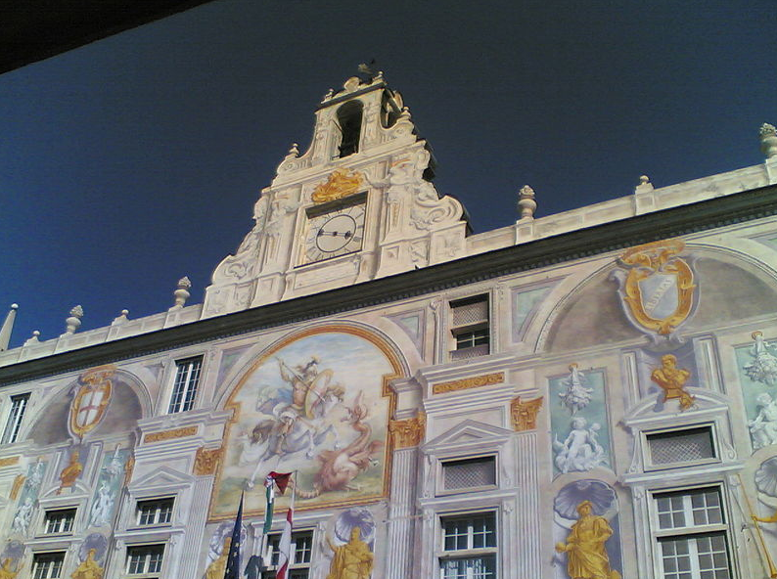
９．Banks and Bank Money 銀行と銀行貨幣
Moneylender or money changer in the Middle Ages中世の金貸しや両替商
⇒developed to bank in the Modern Ages 近世の銀行へ発展
Banco means a woody table in Italian that was used for money exchange by money lender or money changer
Bancoはイタリア語で金貸しや両替商が両替業務に用いた木の長い机を意味する
The first state deposit bank,Banco di San Giorgio (Bank of St. George), was founded in 1407 at Genoa, Italy
最初の国立預金銀行は
1407年にイタリアのジェノアで設立された
バンコ・ディ・サンジョルジョ

Slide 15
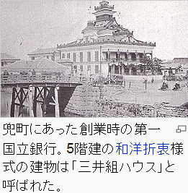
９B．Banks and Bank Money 銀行と銀行貨幣
The First National Bank in Japan founded in 1873日本の第一国立銀行は1873年に設立
They issued their own bank note on the condition to exchange it for legal tender
彼等は自身の銀行券を法貨との交換を条件に発行した
＝bank money=inside money 銀行貨幣＝内部貨幣
State monopoly of the mintage right …legal tender＝outside money
国家は造幣権を独占…法貨＝外部貨幣
⇒banks produced current (checking) account
that can make payments by issuing checks
銀行は小切手の発行により支払をできる
当座勘定（小切手勘定）を創設
＝deposit money=inside money
預金貨幣=内部貨幣

Slide 16
10．Basic Functions of Money
貨幣の本源的機能
①Measure of Value 価値尺度
or Accounting Unit 計算単位←divisibility 分割可能性
a function to measure precisely the value of goods and services and to express the exchange proportion between them before they are transacted 取引に先立って財貨・用役の価値を正確に測定し、それらの交換比率を表象する機能
②Means of Exchange 交換手段←portability 携帯可能性
a function to be exchanged for any goods and services as an intermediation of transactions 取引の仲介手段としてどんな財貨・用役とも交換される機能
③Store of Value 価値貯蔵手段←durability 耐久性
a function to carry over the value to the future 価値を将来へ持ち越す機能

Slide 17
11．Derivative Functions of Money
貨幣の派生的機能
＝a function that is derived from the basic functions of money
貨幣の本源的機能から派生する機能
①Means of Payment 支払手段
a function to pay loan, debt, and tax
借金や負債を返済し、税金などを支払う機能
②Transporter of Value 価値輸送手段
a function to transport the value to distant places
価値を遠隔地に輸送する機能

Slide 18
12．Contemporary Money 現代の貨幣
Money in the narrow sense 狭義の貨幣＝Ｍ１
＝Cash Currency + Demand Deposits 現金通貨＋要求払預金
①Ordinary Deposits…to pay consumption payments and public utility charges by deposit transfer or credit card
普通預金…預金の振替やクレジットカードにより消費代金や公共料金を支払う
②Current Account…to make payment by issuing a check
当座預金…小切手を振り出して支払をする
Money in the broad sense 広義の貨幣＝Ｍ２
＝Ｍ１＋Time Deposits M1+定期性預金
Time Deposits=Quasi-Currency, Near Money
定期性預金＝準通貨、近似貨幣
…to be used for making payment by overdraft or cancellation
当座貸越や解約により支払に使うことができる

Slide 19
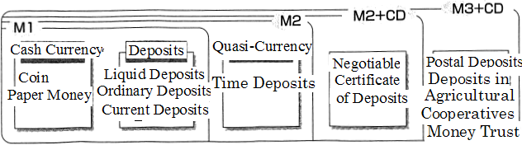
12B．Contemporary Money 現代の貨幣
M2+CD …M2+
Negotiable Certificate of Time Deposits
M2+譲渡性定期預金
M3+CD…Postal Deposits + Deposits in Agricultural Cooperatives
+ Money Trust + CD
郵便貯金＋農協への預金＋金銭信託７＋CD

Slide 20
13．Money and Fund 貨幣と資金
Fund 資金＝money to be used for a particular purpose
ex. a scholarship fund, an investment fund, a housing fund,
marriage fund etc. 特定の支出目的に使われる貨幣 例：奨学資金、投資資金、住宅資金、結婚資金
revenue>funds for expenditure…surplus unit
収入金額＞支出金額（支出目的の資金額）…黒字主体
revenue<funds for expenditure…deficit unit
収入金額＜支出金額（支出目的の資金額）…赤字主体
finance ＝to lend money from a surplus unit to a deficit unit for a certain period
金融 ＝黒字主体（貸手）から赤字主体（借手）に貨幣を一定期間貸すこと

Slide 21
14. Money and Interest 貨幣と利子
finance ⇒borrowers can buy what they could not buy and feel increased utility
金融⇒借り手は買えなかったものが買えるようになって効用が増加
⇒lenders cannot use money for a lending period and feel disutility
⇒貸し手は一定期間貨幣を使えなくなるので、不便を被る
⇒lenders take interests from borrowers in charge of the disutility
⇒その不便の代価として、借り手から利子を受け取る。
interests = a rent for a rental contract
利子＝賃貸借契約の代価（レント）
lenders…interests>disutility borrowers…increased utility>interests
貸し手…利子＞不便、借り手…増加した効用＞利子、
⇒ financing money increases both lenders’ utility and borrowers’ utility
⇒双方の厚生を高める
the rate of interest = interests / borrowed money
利子率＝利子／貸借金額

Slide 22
15. Debt, Claim and Ownership 債務と債権、所有権
Buying and selling of goods and services= Real right contract with transfer of ownership right
財貨・サービスの売買＝所有権の移転を伴う物権契約
Lending and borrowing of money (finance)=credit debt contract without transfer of ownership right
貨幣の貸借（金融）＝所有権の移転を伴わない債権債
務契約（賃貸借契約）
repayment duty = debt=a borrower’s duty to repay borrowed money by the maturity
返済義務＝債務＝借り手が期限までに貨幣を返済する義務
requires to write an amount of borrowed money, borrowing period, the rate of interest on the promissory note = bonds, securities
借用証書（債務証書） に借りる金額、期間、利子率（代価）を定める必要
＝債券、証券

Slide 23
16. Meaning and Role of Finance
金融の意味と役割
Credit＝to lend money to a borrower believing that the borrower will keep his repayment obligation
信用＝借り手が返済義務を守るものと信用して貸し手が貸すこと
Giving credit＝to lend money and hand over a bond in return and to return the bond at the due date
与信＝貨幣を貸して債務証書を受け取ること、
貨幣返済時には証書を返済する
Receiving credit＝to borrow money and receive a bond in return and to take back the bond at the due date
受信＝貨幣を借りて債務証書を貸与すること、
貨幣返済時には証書を取り戻す

Slide 24
17. Financial Assets and Liabilities
金融資産と金融負債
Assets＝Tangible and/or intangible properties that have economic value
資産＝経済的価値を持つ有形無形の財産
Tangible fixed assets＝Tangible physical property such as plant, machinery and other real capital
有形固定資産＝工場や機械などの資本は有形の物的財産
Intangible assets＝Intangible property such as reputation and brand
無形資産＝暖簾やブランドなどのように無形の価値を持つ資産
Financial Assets＝Claims owed by a lender or certificates that state these claim conditions
金融資産＝貸し手が保有する債権またはそれを証書で明記した債券
Financial liabilities＝Repayment obligations or liabilities held by a borrower
金融負債＝借り手が保有する返済義務または債務、
Financial assets and liabilities are corresponded and offset each other
金融資産と金融負債は相互に相殺関係

Slide 25
18．Liquidity of Assets 資産の流動性
Liquidity＝a nature of goods that can be exchanged for any goods, at anytime and anywhere
流動性＝何時でも何処でも何とでも交換できるという財の性質
perfect liquidity = money
完全流動性＝貨幣
An asset has higher liquidity, as it has a higher convertibility for money or higher liquidity.
貨幣との交換可能性または換金性が高い資産ほど、高い
流動性をもつ

Slide 26
19．Industrial and Financial Circulations
産業的流通と金融的流通
Direct exchange or barter ⇒ People buy goods by goods.
物々交換⇒財で財を買う
Indirect exchange ⇒ People buy goods by money and buy money by goods.
間接交換経済⇒貨幣で財を買い、財で貨幣を買う
Keynes distinguished industrial circulation of money
from financial circulation.
ケインズ…貨幣の産業的流通
金融的流通

Slide 27
20. Purposes of Money and Finance
金融論の課題
Monetary theory 金融理論
① to analyze the monetary economy from the viewpoint of money and to clarify the role of finance in the economy
貨幣（カネ）の流れに沿って貨幣経済を分析し、
貨幣や金融が果たす役割を明確化
② to investigate how money and finance relate with and affect the real economy to each other.
貨幣の産業的流通と財（モノ）の流れからなる実物経済との関連を解明
Monetary policy 金融政策
③ to inquire how we can improve the real economy by conducting monetary policy
貨幣や金融の政策的コントロールを通じて、実物経
済の成績をあげることを研究

