Slide 1
Part 2 Microeconomic Analysis of Finance 金融のミクロ分析 Chapter 5 Corporate Finance 企業の金融
Naotsugu HAYASHI 林 直嗣
Professor of Economics 経済学教授
Faculty of Business Administration 経営学部
Hosei University 法政大学

Slide 2
1. Purpose of Firm and Profit Maximization
企業の目的と利潤最大化
Firm, enterprise = a basic unit of production = an organization that inputs labor, capital etc. and outputs products
Profit = Revenue – Cost
Purpose of a firm = to maximize profits = to maximize sales revenue and to minimize cost of production
Firm = organization of going concern ⇒ maximization of long-run expected profits
Long-run expected profits =π_{０}＋π_{１}/(1+r)＋π_{２}/(1+r)^{２}＋…＋π_{ｎ}/(1+r)^{ｎ}
Discounted present value of flows of expected profits
企業＝生産の基本組織
＝労働や資本等の生産要素を投入し、生産物を産出する基本組織
利潤＝収入－費用
目的⇒ 利潤最大化＝収入最大化－費用最小化
企業⇒永続的組織（ ゴーイング・コンサーン）ゆえ
短期的利潤最大化ではなく、長期的予想利潤最大化
長期予想利潤＝予想利潤の流列の割引現在価値の総和

Slide 3
2. Maximizing Stock Price
株価最大化
(joint-)stock company
if stock market is perfectly competitive and are not influenced at all by macroeconomic conditions
⇒ corporate long-term expected profits
= the discounted present value of a future flow of profits
are reflected properly to the market value of stock
⇒ profit maximization is equal to maximization of stock price
株式会社の場合、株式市場が完全市場なら、
⇒企業の長期予想利潤は、株価に反映され、企業の市場価値を表す
⇒利潤最大化は株価最大化と一致

Slide 4
3. Sources and Expenditures of Funds 資金の源泉と使途
① Sources of corporate funds ＝ operating revenue + sales of financial assets + increase in financial debt + sales of real assets.
② Expenditures of corporate funds = production costs + purchases of financial assets + repayment of financial debt + purchases of real assets.
Since ①＝②,
Profit = operating revenue - production costs = savings = net increase in financial assets + net increase in real assets
= financial investment + real investment = investment
Profit利潤⇒Retained earnings (Savings) ⇒ Investment
①資金源泉＝収入＋金融資産売却＋金融負債増加＋実物資産売却
②資金使途＝費用＋金融資産増加＋金融負債返済＋実物資産増加
①＝②ゆえ、
利潤＝収入－費用＝貯蓄＝金融資産増加－金融負債増加＋実物資産純増
＝金融資産純増＋実物資産純増
＝金融投資＋実物投資 ＝投資
利潤⇒内部留保（貯蓄）⇒投資

Slide 5
4. Raising and Use of Funds 資金の調達と運用
③ Raising and Use of Funds
Real investment – Savings = increase in financial debt – increase in financial asset
Real investment > Savings ⇒ Deficit unit increases financial debt or sales financial asset
∴ real investment + increase in financial asset = savings + increase in financial debt
Use of funds = raising of funds by internal and external finance
③ 資金の調達と運用
実物投資－貯蓄＝金融負債増加－金融資産増加
実物投資＞貯蓄…赤字主体⇒金融負債を増やすか、金融資産を売却するか、
実物投資＋金融資産増加＝貯蓄＋金融負債純増
左辺は資金の運用、右辺は資金を貯蓄という内部金融と借入等の外部金融で調達

Slide 6
5. Meanings of Corporate Finance 企業金融の意味
One of the most important decision makings for a corporation ⇒ to decide real investment to increase future profits and to decide how it finances real investment
① how to invest or use funds
real investment + financial investment
= equipment investment (in fixed capital such as machinery, factory, buildings and land) + inventory investment (raw materials, half-finished and final products)
② how to raise funds
internal finance (retained earnings) + external finance (borrowings)
⇒ corporate finance
企業の最重要な意志決定の一つ⇒将来利潤を増加させるための投資と資金調達
①資金をどう投資・運用するか、
実物投資と金融投資
設備投資=工場、建物、機械設備など固定資本への投資
在庫投資＝原材料、仕掛品、生産物の在庫保有
②その資金をどう調達するか、
内部留保等の内部金融＋借入等の外部金融
⇒この金融を企業金融（コーポレート・ファイナンス）、企業財務

Slide 7
6. Fund Raising Costs 資金調達コスト
fund raising cost ＝a cost to be paid to fund suppliers by a corporation
interest on borrowed money, interest on corporate bonds, dividend on stocks.
capital cost = a rate of return at least necessary for lending money, opportunity cost
Profit rate < capital cost ⇒this investment project is not carried out
∴capital cost is a cut-off rate for investment
資金調達コスト＝資金を調達するために資金の供給者に支払う費用
借入⇒借入利子、社債⇒社債利子、株式⇒配当
資本コスト＝資金の供給者にとって最低限必要な収益率、機会費用
利潤率＜資本コスト⇒この投資プロジェクトは実行されない
∴資本コストは投資のカットオフ・レート（cut-off rate）
とも呼ばれる

Slide 8
7. Marginal Efficiency of Investment and Optimal Investment
投資の限界効率と最適投資
Keynes’s marginal efficiency of investment
= an increase in future revenue expected when investment is increased by one unit = a discount rate r that equalizes an investment cost I to a discounted present value of the flow of future profits
= internal rate of return
I＝π_{０}＋π_{１}/(1+r)＋π_{２}/(1+r)^{２}＋…＋π_{ｎ}/(1+r)^{ｎ}
ケインズの投資の限界効率（marginal efficiency of investment）
＝投資を１単位増やすときに期待される将来収益の増分
＝投資にかかる費用Iと、その将来収益流列の割引現在価値とを
等しくする 割引率r
＝内部収益率

Slide 9
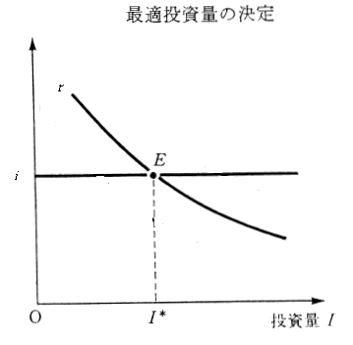
7-2. Marginal Efficiency of Investment and Optimal Investment
投資の限界効率と最適投資
Companies will carry out better investment opportunities in order for higher profitability ⇒a profitability of investment or the marginal efficiency of investment will decrease, as companies increase investments
⇒ downward sloping curve of investment demand
If perfect competition, cost of capital = market rate of interest
⇒ optimal investment is determined when marginal efficiency of investment = market rate of interest (+ risk premium when risk exists)
Tobin’s q = Marginal Efficiency = market rate of interest
ｑ≧１⇒investment is conducted
企業は有利な投資機会から実行⇒投資の限界効率は低減⇒右下がり投資需要曲線
完全競争の場合⇒資本コスト＝市場利子率⇒投資の限界効率＝市場利子率
という点で企業は最適投資を決定
リスクを伴う場合⇒市場利子率＋リスク・プレミアム
＝投資の限界効率
投資の限界効率／市場利子率
＝トービンのｑ（Tobin's q）
ｑ≧１⇒投資実行

Slide 10
8. Inventory Investment 在庫投資
the demand for their products increases than they expected
⇒ Firms increase the supply of their products by releasing inventory
the demand for their products decreases
⇒ decrease the supply of their products by piling up inventory
cost of adjusting production > Costs of adjusting inventory
⇒ inventory adjustment at first
inventory holdings are a result of unintended gap between demand and supply in the short run, but there is an optimum level of inventory in the long run
the marginal benefit of smoothing the adjustment between demand and supply of products = the marginal cost of holding inventory investment
⇒ optimum level of inventory is determined
予想以上の販売増加⇒在庫を取り崩して市場に供給
予想以上の販売減少⇒在庫を積み増して市場への供給抑制
生産量調整の費用＞在庫調整の費用⇒最初に在庫調整
在庫保有量は短期的には意図せざる需給不一致の結果
長期平均的には最適な在庫水準が存在
在庫投資の限界費用＝在庫保有による限界便益

Slide 11
9. Inside (Internal) Finance 内部金融
Inside Finance ⇒inside funds such as retained earnings and depreciation allowance
Outside (External) Finance
⇒ equity finance stocks own capital
convertible bonds, warrant bonds
debt finance corporate bonds borrowed capital
bank loans
Internal Finance
Retained earnings=current term net profits after deduction of dividends, executive remunerations and taxes
Depreciation=Machinery, factories, buildings and other tangible fixed assets depreciate
内部金融⇒内部留保や減価償却費など内部資金による資金調達
外部金融⇒エクイティ・ファイナンス 株式、転換社債、ワラント債 自己資本
デット・ファイナンス 社債、金融機関借入 他人資本
内部金融……返済の必要がなく、利子や配当を払う必要もない資金
内部留保＝当期利益－配当・役員賞与・税金など社外への流出分
減価償却費＝機械設備、工場、建物などの有形固定資産の減耗分を補填 する積立金、

Slide 12
10. Outside (External) Finance 外部金融
External Finance = raise funds through outside finance such as stocks (own capital), corporate bonds and bank borrowings (borrowed capital)
Stocks ⇒ equity capital as retained earnings and are not necessary to be repaid but have to pay dividends to stock holder, direct finance
Corporate bonds ⇒ borrowings through capital markets and stipulate beforehand the rate of interest and the deadline for repayment, direct finance
Bank borrowings ⇒ borrowing from financial institutions such as banks, which stipulates the rate of interest and the deadline for repayment, indirect finance
外部金融＝株式（自己資本）、社債・借入（他人資本）など外部資金による資金調達
株式⇒内部留保等と同様に自己資本を形成、返済不必要、株主に対し配当支払
社債⇒資本市場を通じる企業の借入であり、支払利子と償還期限
株式と社債の発行は直接金融
借入⇒銀行など金融機関からの借入であり、支払利子と返済期限
銀行借入は間接金融

Slide 13
11. Equity Financing and Debt Financing
エクイティ・ファイナンスとデット・ファイナンス
Equity Finance ⇒ Own capital
Stocks
Convertible bonds= a bond that is issued as a corporate bond and can be converted to stock after a certain period
Warrants = a corporate bond that has a right to undertake a new stock which will be issued in the future
エクイティ・ファイナンス⇒自己資本を構成
株式
転換社債（転換社債型新株予約権付社債）＝発行時は社債だが、一定期間経過後に株式に転換可能
ワラント債(新株予約権付社債)＝将来発行予定の新株を引き受ける権利を付けた社債
Debt Finance ⇒ Borrowed capital
ordinary corporate bonds, bank borrowings
デット・ファイナンス⇒他人資本を構成
普通社債、金融機関借入

Slide 14
12. MM Proposition under Perfect Competition
完全競争下のMM命題
Modigliani and Miller
<Assumption> company's goal is to maximize stock price, the stock market is perfectly competitive, yet if there is no corporate taxes,
The first proposition
⇒companies whose expected operating profits are the same have the same total value = total value of stocks + total value of debt value, regardless of their capital structure
The second proposition
⇒whether a company finances new investment by debt, stock or retained earnings is indifferent to stockholders
モジリアーニ＝ミラー
＜仮定＞企業の目的が株価最大化、株式市場が完全競争市場、法人税が存在しない場合
第１命題⇒営業利益の予想が同じ企業の総価値（＝株価総額＋負債総額）は、
資本構成に関わらず等しくなる。
第２命題⇒企業が新規の投資を行うときに、資金調達方法が負債、株式、内
部留保によるかは、株主にとってまったく無差別

Slide 15
13. Imperfect Non-frictions and Transactions Costs
不完全無摩擦性・取引費用
When there are corporate taxes and other transaction costs, non-frictions of market become imperfect
⇒ Corporate tax is imposed on operating earnings after deducting debt interests as necessary costs
⇒debt is more advantageous than other financing methods, but equity ratio falls as debt becomes too much and the default risk increases
⇒ when a balance of these two factors is achieved, an optimum structure of capital will be determined
⇒the MM propositions to be amended
法人税などの取引費用が存在
⇒負債の支払利子を必要経費として控除した営業利益に課税
⇒負債の方が有利、負債が多すぎると自己資本比率が下がり、
倒産リスクが増大
⇒両者のバランスが取れた所で最適資本構成
株式発行費用、社債発行費用、銀行借入に伴う審査等の費用 は異なる
⇒MMの命題は修正される

Slide 16
14. Information Asymmetry and Agency Costs of Stockholders
情報の非対称性と株主のエージェンシー費用
① agency relationship between stockholders and managers
After the separation of management from ownership of capital ( the so-called manager revolution)
⇒ stockholders entrusted managers with management
⇒ managers have much more information on management than stockholders
= information asymmetry
⇒ Stockholders monitor managers but imperfect
⇒ managers tend to use the money got by issuing stocks not for stockholders but for themselves = moral hazard =agency slack
⇒ cause agency costs of issuing stocks to increase= agency cost of issuing stocks
①株主と経営者とのエージェンシー関係( 依頼人・代理人関係）
所有と経営の分離（経営者革命）
⇒株主による経営者のモニタリング⇒不完全
⇒株式発行で得た資金を株主のためにではなく経営者のために使うモラル・ハザード＝エージェンシー・スラック
その分株式発行コストが増える
⇒株式発行のエージェンシー費用

Slide 17
15. Information Asymmetry and Agency Costs of Creditors
情報の非対称性と債権者のエージェンシー費用
② Agency relationship between creditors and owner managers
Owner manager (capitalist) has more information than creditors
Information asymmetry
⇒ monitoring by creditor is imperfect
the principle of stockholder’s limited liability⇒ managers tend to impute a loss to creditors by issuing bonds, if the loss exceeds stockholder’s liability
⇒ This moral hazard causes agency costs of issuing bonds to increase
= agency cost of issuing corporate bonds
②債権者と創業経営者（オーナー経営者）とのエージェンシー関係
債権者によるモニタリングは不完全
⇒株主有限責任原則⇒それを超える損失は負債発行により債権者に転嫁
その分社債発行コストは増える⇒負債発行のエージェンシー費用
⇒さまざまな場合にエージェンシー費用は異なる⇒MMの命題は修正

Slide 18
16. Pecking Order Theory ペッキング・オーダー理論
companies tend to raise funds in the order from lower-cost method
① Internal funds……raising costs are relatively smaller than other method
② Bank loans……examination costs, contract costs and agency costs are not so expensive
③ Issuance of stock and corporate bonds……issuing costs and agency costs are relatively expensive
資金調達費用の安い方から一定の順序に従った資金調達
①内部資金…事務費用は比較的に小さい
②銀行借入…審査費用、契約費用、エージェンシー費用は
あまり大きくない
③株式・社債発行…発行費用、エージェンシー費用は高い

Slide 19
17. Corporate Governance: Internal Governance
企業のガバナンス：内部的ガバナンス
Corporate Governance = to disciple corporate management
① Internal Governance ② External Governance
① Internal Governance = to disciple management from inside
If managers cannot achieve their goal of profit maximization
⇒ the board of directors and labor union will criticize their responsibility
If managers cannot achieve good performance of profits and wages,
⇒ labor union will put them pressure to improve
Auditors, outside auditors and outside directors
⇒ regularly audit and examine management in order to avoid inefficiency and waste of management
企業統治・企業協治＝企業経営の規律付け
① 内部的ガバナンス ② 外部的ガバナンス
内部的ガバナンス＝企業内部からの規律付け
利潤最大化目標⇒市場によるドル投票
⇒達成できなければ取締役会や労働組合から責任を問われる
経営者と労働組合との拮抗関係（countervailing power）
監査役、社外監査役による監査（auditing）

Slide 20
17. Corporate Governance: External Governance
企業のガバナンス：外部的ガバナンス
② External Governance = to disciple management from outside
Stockholders ⇒ enforce their governance to determine important matters in a general meeting of stockholders, or to influence a fall of stock prices in the stock market or take-over bid of stocks
Creditors ⇒ enforce their governance to ask managers’ responsibility, if they delay in carrying out payment of interests and repayment of debt to cause default risk
consumers and the market ⇒ criticize their responsibility by voting in the market, if managers cannot achieve their goal of profit maximization and social responsibility
supervisory authorities ⇒ guide them, if so
外部的ガバナンス＝企業外部からの規律付け
株主⇒株主総会での議決権行使を通じて重要事項を決定
株式市場での株価低下、株式公開買い付け（take-over bid;TOB）
債権者 ⇒毎期の利子支払い、満期の償還など元利返済義務の履行
⇒履行しないと倒産リスク、経営者の責任を問う
消費者⇒消費者主権の行使
市場や官庁⇒行政指導や監督を通じてガバナンス

Slide 21
18. Separation of Management from Ownership
所有と経営の分離
Ownership = a absolute and exclusive right of controlling a property = the right to use it, the right to earn revenue by using it, the right to dispose it
⇒ to be sold at a point of time based on a sales contract to transfer the ownership
所有権＝客体(有形無形の正味財産)に対する絶対的・排他的な支配権
所有権の中身＝客体を使用する権利、それを利用して収益を上げる権利、それを処分する権利
所有権は売買契約により一時点で売買処分でき、所有権が移転する。

Slide 22
18B. Separation of Management from Ownership
所有と経営の分離
Rights derived from ownership = the right to use it, the right to earn revenue by using it,
that are lent for a certain period on the basis of a lending and borrowing contract
Their certificate = a certificate of lending and borrowing contract, a due bill, a certificate of indebtedness, a bond, or etc.
claim and debt agreements, because a claim corresponds to a debt on the opposite side, they cancel out to each other ⇒ claims do not make up net asset or net wealth.
If an owner of land lends the rights to use it and to earn revenue to a borrower, the land becomes a leased land. If an owner of corporate capital lends the rights to use it and to earn revenue to a manager, the right of management becomes separated from the ownership right of capital.
所有権から派生する権利＝客体の使用権と収益権、賃貸借契約により一定期間貸借できる
賃貸借契約の要件⇒賃貸借期間と賃貸借料
その証書＝賃貸借契約書、借用証書、債務証書、債券
債権契約であり、債権と債務は相殺し合い、正味資産は構成しない。
土地の使用収益権を賃貸借すれば借地、家の使用収益権を賃貸借すれば借家、車の使用収益権を賃貸借すればレンタカー、企業資本の使用収益権を賃貸借すれば経営権は所有権から分離する。

Slide 23
18C. Separation of Management from Ownership
所有と経営の分離
Ownership = a absolute and exclusive right of controlling the object.
Barle = Means (1932) in The Modern Corporation and Private Ownership They defined a right of controlling corporation as a substantial right to select the board of directors or a majority of the board of directors, and distinguished the following five categories.
(1) almost complete control by ownership (80% or more voting rights),
(2) control by holding a majority stocks (50 to 80 percent of voting rights),
バーリ＝ミーンズ(1932)『近代株式会社と私的所有』
「支配」＝取締役会または過半数の取締役を選出する実質的権限と定義、次の5分類。
①ほぼ完全な所有権による支配（80％以上の議決権）、
②過半数の持株による支配（50～80％の議決権）、

Slide 24
18D. Separation of Management from Ownership
所有と経営の分離
(3) control by legal methods (control by law such as the organizing non-voting shares and voting trust),
(4) control by minority share-holding (the voting rights by 50 to 20 percent share-holding that can enforce more than 50 percent voting rights in some way),
(5) manager control (the voting rights by 20% or less share-holding, there is no individual or collective ownership to be sufficient to control the corporation because of the diffusion of stocks, and the managers can control the corporation in fact though they have merely 20% or less share-holding.
③法律的方法による支配（無議決権株、議決権信託の組織化等の法律的手段による支配）、
④少数持株支配（50～20％の議決権、何らかの方法で50％以上の議決権を行使しうる支配）、
⑤経営者支配（20％未満、株式分散により支配するに十分な株式所有をする個人や集団が存在せず、現経営者が実質的に支配する形態）

Slide 25
19. Japan’s Main Bank System and Cross-Shareholding
日本のメインバンク制と株式持ち合い
the World War 2 ⇒ destruction of production facilities, the stock market underdeveloped
⇒ banks collected deposits from people throughout Japan to lend them to companies.
= indirect finance dominating system
Government’s regulations
Artificially low interest-rate policy ⇒ massive amount of growth money with low pressure of repayment
the escort fleet method in order not to smash a bank even under the very low equity ratio
⇒ a dominant bank becomes a core of a group of companies = the main bank system
Similar to West Germany
戦争で生産設備の破壊、証券市場の未発達
⇒国民の零細預金を銀行が纏めて企業に融資＝間接金融優位方式
＜政府の規制＞人為的低金利政策により低利で返済圧力が小さい成長通貨を豊富に供給
低自己資本比率⇒護送船団方式で１行も潰さず倒産リスク抑制
⇒主力銀行をコアとするメインバンク制の企業集団…西ドイツと類似

Slide 26
19B. Japan’s Main Bank System and Cross-Shareholding
日本のメインバンク制と株式持ち合い
cross-shareholding in the group of companies, to oppose merger and acquisition by foreign companies under the liberalization of capital
⇒ companies listed on the Stock Exchange 40~50%
6 big groups of companies 50~60%
(2) control by holding a majority stocks (50 to 80 percent of voting rights) Barle=Means
⇒ to weaken the governance by the general stockholders and by the stock market
called manager’s dominance, but stockholders’ dominance in fact
⇒ monitoring by a main bank = creditor’s governance
⇒ after 1990 the bubble of economy burst, massive amount of bad loans appeared,
⇒ they weakened managerial power of banks and the main bank system as well.
⇒ Cross-shareholdings retreated and the government stopped the escort fleet method
資本自由化に対抗し、企業集団内で株式持ち合い
上場企業全体では40％～50％台、6大企業集団では50％～60％）
バーリ=ミーンズの分類では②過半数の持株による所有者支配（50～80％の議決権）
⇒一般株主や株式市場のガバナンスは弱化、「シャンシャン総会」
「経営者支配」と呼ばれたこともあったが、実態は所有者支配
⇒メインバンクによるモニタリング機能＝債権者のガバナンス
⇒1990年代からバブル崩壊と不良債権の大量発生
⇒メインバンク制と株式持ち合いが後退、護送船団方式の放棄
⇒直接金融、資本市場によるガバナンスが発展する必要

Slide 27
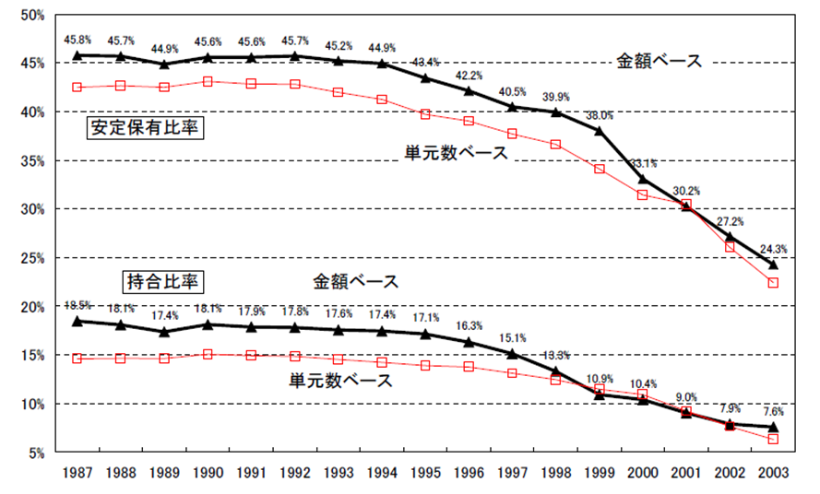
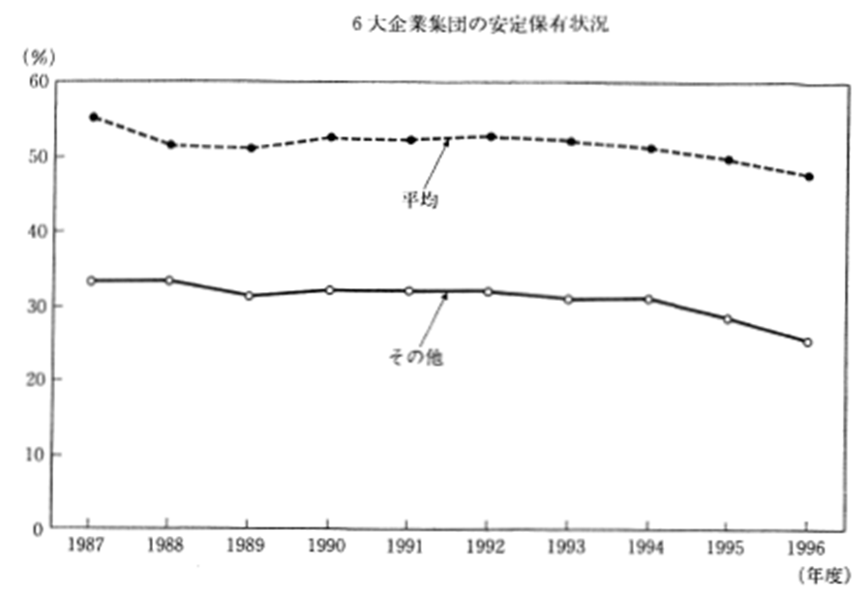
19C. Japan’s Main Bank System and Cross-Shareholding
日本のメインバンク制と株式持ち合い
Stable holdings & Cross-Shareholding Stable holdings by 6 big groups
市場全体の安定保有と株式持合 6大企業集団の安定保有状況
Cited from Nissei Basic Research Center(1997, 2003)
ニッセイ基礎研究所(1997)より引用 ニッセイ基礎研究所(2003)より引用

Slide 28
＊. Pareto Optimum & Tinbergen’s Theorem
パレート最適とティンバーゲンの定理
Pareto Optimum＝Optimal state where you cannot get better off any more, without making worse others’welfare in any aspects.
* The EU is not in a state where the EU cannot get better off any more, without making worse UK’s welfare in some aspects, and vice versa.
* Any country has a fundamental right to refuse free immigration of people, even though it approves free trade of commodities and free capital movements across countries.
* In modern democratic societies, any treaties should be negotiated spontaneously by the involved countries, and any dictatorship should be denied.
Tinbergen’s Theorem =A country needs at least N policy instruments in order to achieve N policy objectives.
* In order to achieve price stability, you need to have monetary policy to control the money supply or interest rates. PIIGS countries lost monetary policy because they participated the EURO. Their price stabilities are not the policy objectives of the ECB.
* In order to restore trade balance, you need to have exchange rate policy. When the trade balance got in deficit, exchange rate will depreciate and promote export to restore trade balance. PIIGS countries lost these policy instruments to restore trade balance.
Cited from Nissei Basic Research Center(1997, 2003)
ニッセイ基礎研究所(1997)より引用 ニッセイ基礎研究所(2003)より引用

