Slide 1
Part 2 Macroeconomic Analysis of Finance 金融のマクロ分析 Chapter 7 IS=LM Analysis, Monetary and Fiscal Policies ＩＳ＝ＬＭ分析と金融・財政政策
Naotsugu HAYASHI 林 直嗣
Professor of Economics 経済学教授
Faculty of Business Administration 経営学部
Hosei University 法政大学

Slide 2
1. Goods Market Balance and IS Curve
財市場均衡とＩＳ曲線
Product (Goods) Market
Aggregate Demand = Y =consumption C +investment I (+ Government expenditure + Net export: deleted )
Aggregate Supply = Y^{Ｓ}in real terms
Consumption and investment are a function of income Y and interest rate i
C＝C(Y, i) I＝I(Y, i)
At equilibrium Y^{Ｓ}＝Y＝C(Y,i)+I(Y,i)
By definition Y = C + S
生産物（財）市場（product market）
総需要＝Y＝消費C＋投資I（＋財政支出＋純輸出：捨象）
総供給＝Y^{Ｓ}、両者ともに実質値
消費も投資も所得Yと利子率iの関数 C＝C(Y,i) I＝I(Y,i)
均衡では Y^{Ｓ}＝Y＝C(Y,i)＋I(Y,i)
定義により 所得Y＝消費C＋貯蓄S

Slide 3
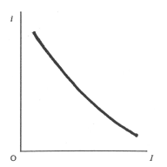
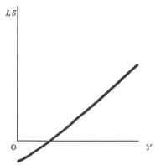
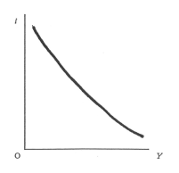
1B. Goods Market Balance and IS Curve
財市場均衡とＩＳ曲線
⇒ from the two equations, C+I＝C+S ∴ I = S Investment＝Savings balance
expresses the equilibrium at goods market
all the combinations of Y and I which satisfy I(Y,i)＝S(Y,i) is IS curve
When interest rate is high (low), income is low (high). ⇒ downward-sloping
⇒両式より C＋I＝C＋S ∴ I = S 投資＝貯蓄バランス
∴I＝S 投資＝貯蓄は財市場均衡を表す
I(Y,i)＝S(Y,i)という財市場均衡を満たすYとiの組み合わせ＝ＩＳ曲線
利子率が高ければ所得は低く、利子率が低ければ所得は高い…右下がり曲線
Marginal Efficiency of Investment
Savings Curve
IS curve＝Goods market equilibrium

Slide 4
2. Money Market Equilibrium and LM Curve
貨幣市場均衡とＬＭ曲線
Money (fund) market
Aggregate money demand = M^{Ｄ}((Y,i)／P＝L(Y,i)＝kY+L(i)
Real money demand = transactions demand + Speculative demand
= Active balance + Idle balance
…Liquidity preference theory
Aggregate money supply = M／P in real terms
貨幣（資金）市場
総貨幣需要＝M^{Ｄ}(Y,i)／P＝L(Y,i)＝kY＋L(i)
実質貨幣需要＝取引需要＋投機的需要
＝活動残高＋遊休残高
…流動性選好説
総貨幣供給＝M／P、両者ともに実質値

Slide 5
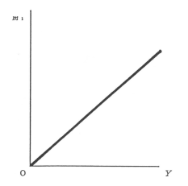
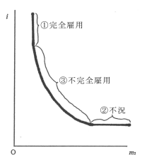
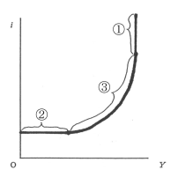
2B. Money Market Equilibrium and LM Curve
貨幣市場均衡とＬＭ曲線
At equilibrium, M／P＝M^{Ｄ}((Y,i)／P＝L(Y,i)＝kY+L(i)
all the combinations of Y and I which satisfy M／P＝L(Y,i) is LM curve
When interest rate is high (low), income is high (low). ⇒ upward-sloping
均衡ではM／P＝M^{Ｄ}(Y,i)／P＝L(Y,i)＝kY＋L(i)
M／P＝L(Y,i)という貨幣市場均衡を満たすYとiの組み合わせ＝ＬＭ曲線
利子率が高ければ所得は高く、利子率が低ければ所得は低い…右上がり曲線
Transactions demand for money
Speculative demand for money
LM curve

Slide 6
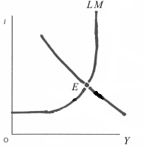
3. Simultaneous Equilibrium of Goods and Money Markets
財市場と貨幣市場の同時均衡
Equilibrium condition in goods market I(Y,i)＝S(Y,i) ⇔ IS curve
Equilibrium condition in money market M／P＝L(Y,i) ⇔ LM curve
At the intersection of the two curves ⇒ Simultaneous equilibrium
⇒ determine both the equilibrium income Y* and the equilibrium interest rate i*
partial market equilibrium cannot determine a set of Y* and i*
財市場均衡条件式 I(Y,i)＝S(Y,i) ⇔ＩＳ曲線
貨幣市場均衡条件式 M／P＝L(Y,i) ⇔ＬＭ曲線
両者の交点で両市場の同時均衡が決定、
⇒均衡所得Y＊と均衡利子率i＊が決まる
片方の市場均衡だけでは、
均衡所得Y＊と均衡利子率i＊ は決まらない
Simultaneous equilibrium

Slide 7
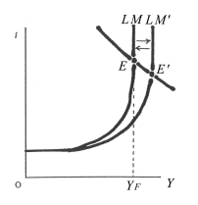
4. Full Employment and LM Curve
完全雇用とLM曲線
Full employment ⇒labor is fully employed, capital equipment is fully working
⇒ national products are maximized to their limit, Y_{Ｆ}
The money demand curve stands vertically.
L’(i) = 0, the money demand is inelastic to interest rate.
LM curve stands vertically
⇒ the classical and monetarist quantity theory of money holds.
完全雇用 = 労働と資本の完全雇用
⇒完全雇用国民所得Y_{Ｆ}
ＬＭ曲線は垂直、L'(i)＝0、貨幣需要は利子非弾力的、
⇒マネタリストの貨幣数量説が妥当
Full employment and LM curve

Slide 8
5. Full Employment and Monetary Policy (1)
完全雇用と金融政策
①Easy-Money Policy
⇒ increases M ⇒ LM curve shifts a right side to LM’ ⇒ i falls, Y increases
…the first-round effects
the second-round effects or the ultimate effects.
⇒ at full employment real income Y does not increase, nominal income PY increases ⇒ the price level P rises ⇒ M/P decreases ⇒ LM curve shifts back to the left
…Real Balance Effect = Pigouvian Effect
⇒ Y and I go back, only P rises ⇒ M determines P (Quantity theory of money)
Neutrality of money, No effect of monetary policy
金融緩和政策
金融緩和で貨幣供給量増加⇒ＬＭ曲線の右方シフトＬＭ’へ
⇒利子率は低下し、所得は増える =一次的効果
二次的効果ないし究極的効果
⇒完全雇用ではＰＹの増加だけ、物価Pが上昇
⇒M／Pの減少⇒ＬＭ曲線は左方シフトで戻る
…実質残高効果、ピグー効果
⇒実質所得Yも名目金利iも元に戻り、物価Pだけが上昇
⇒MがPを決めるという貨幣数量説、
貨幣の中立性、政策効果なし
Full employment and Moetary policy

Slide 9
５B. Full Employment and Monetary Policy (2)
完全雇用と金融政策(2)
②Tight-money Policy
⇒ decreases M ⇒ Lm curve shifts a left side to LM’’ ⇒ i rises Y decreases
…the first round effects
the second round (ultimate) effects
⇒ recession makes P fall ⇒ M/P increases ⇒ LM curve shift back to the right
⇒ Y and i go back, only P falls
⇒ M determines P … Quantity theory of money, Neutrality of money
No policy effect
②金融引き締め政策
金融引き締めで貨幣供給量減少⇒ＬＭ曲線の左方シフトＬＭ”へ
⇒利子率は上昇し、所得は減る 以上が一次的効果
二次的効果ないし究極的効果
⇒景気後退で物価Pが下落⇒実質貨幣供給M／Pの増加
⇒ＬＭ曲線は右方シフトで戻る
⇒実質所得Yも名目金利iも元に戻り、物価Pだけが下落
⇒MがPを決めるという貨幣数量説、貨幣の中立性、政策効果なし

Slide 10
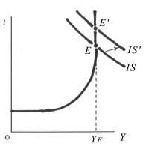
６. Full Employment and Fiscal Policy
完全雇用と財政政策
Positive Fiscal Policy
Increase in government expenditure G ⇒ IS curve shifts a right side to IS’
⇒ At full employment, Y does not increase, only i rises
⇒ Due to the crowding-out effect, fiscal policy has no effect
Resource Allocation Function (administration, defense, police, fire fighting)
①積極財政政策
財政支出Gの増大⇒ＩＳ曲線が右方シフトＩＳ’へ
⇒すでに完全雇用だから所得Yは不変で、
名目利子率iだけが上昇
⇒財政はクラウディングアウト（締め出し）効果
により景気政策の効果なし
ただし資源配分機能はある(行政、国防、警察、
消防など公共財の供給）
Fiscal Policy at Full Employmant

Slide 11
６B. Full Employment and Fiscal Policy
完全雇用と財政政策
② Tight Fiscal Policy
Decrease in government expenditure G ⇒ IS curve shifts a left side to IS”
⇒ At full employment, Y remains unchanged, only i falls
⇒ Due to the crowding-out effect, fiscal policy has no effect
Resource Allocation Function (administration, defense, police, fire fighting)
②財政引き締め政策
財政支出Gの削減⇒ＩＳ曲線が左方シフトＩＳ”へ
⇒完全雇用のまま所得Yは不変で、
名目利子率iだけが低下
⇒財政はクラウディングアウト効果
により景気政策の効果なし
ただし資源配分機能はある
Fiscal Policy at Full Employment

Slide 12
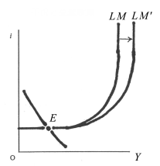
7．Depression and Monetary Policy
不況と金融政策
Under depression, interest rate drops to the lowest limit i_{Ｌ} = Liquidity Trap
LM curve is flat, L'(i)＝∞, money demand is infinitely elastic to i
⇒Keynesian theory of effective demand holds
① Easy-money policy increases the money supply
⇒ LM curve shifts a right side to LM’
⇒ Since interest rate drops to the lowest limit,
Y and I remain unchanged
No policy effect
不況（depression）では利子率は下限i_{Ｌ}
=流動性の罠（liquidity trap）
ＬＭ曲線は水平、L'(i)＝∞、
貨幣需要は利子無限弾力的、
⇒ケインズ派の有効需要説が妥当
①金融緩和政策
金融緩和で貨幣供給量増加
⇒ＬＭ曲線の右方シフトＬＭ’へ
⇒利子率は下限に張り付いているので、
利子率も所得も変化なし、
政策効果全くなし
Depression and Monetary Policy

Slide 13
７B．Depression and Monetary Policy
不況と金融政策
② Tight money Policy
decreases the money supply
⇒LM curve shifts a left side to LM”
⇒ Since interest rate drops to the lowest limit,
Y and I remain unchanged
No policy effect
② 金融引き締め政策
金融引き締めで貨幣供給量減少
⇒ＬＭ曲線の左方シフトＬＭ”へ
⇒利子率は下限に張り付いているので、
利子率も所得も変化なし、
政策効果全くなし
Depression and Monetary Policy

Slide 14
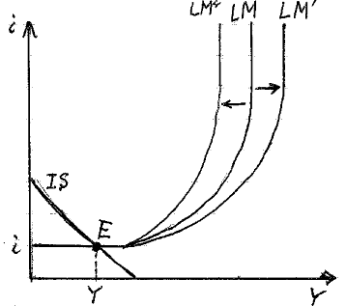
７C． Zero Interest Rate Policy
ゼロ金利政策
③ Zero Interest Rate Policy
The zero-interest rate policy shifts an LM curve downward to LM‘ as Figure ．An interest rate is zero on the part of a liquidity trap. Then the equilibrium point of the IS curve between the LM curve shifts from the point E to the new point E', an equilibrium interest rate drops to zero%, and the equilibrium income increases to Y' through its effect of stimulating investment. However, it is a once and for all effect of stimulating the economy by shifting the LM curve downward to LM'. Once the economy reaches to the zero-interest liquidity trap, no other stimulating effect will occur.
③ゼロ金利政策
ゼロ金利政策によって図のようにLM曲線
はLM’へと下方シフトし、流動性の罠の部分
がゼロ金利となる。するとIS曲線との均衡点は
E点からE’点へとシフトし、均衡利子率は0％
へと低下し、その投資刺激効果により均衡所得
はY’へと増える。しかしそれはLM曲線がLM’
に下方シフトすることによる一回限りの景気回
復効果であり、一旦ゼロ金利になると、それ以
上の景気回復効果はない。
Zero Interest Rate Policy

Slide 15
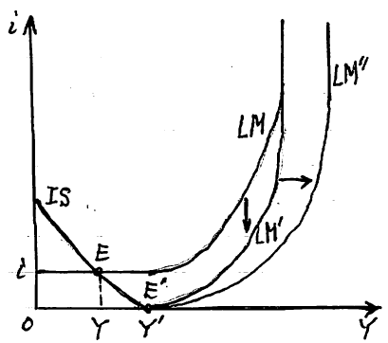
７D． Quantitative Easy Monetary Policy: QE
量的金融緩和政策
③ Quantitative Easy Monetary Policy: QE
Under the zero-interest rate policy, an increase in the money supply shifts the LM curve a right side from LM' to LM" as Figure . However, the equilibrium point E' remains unchanged, because the economy is addicted to the liquidity trap of zero interest rates.
③ 量的緩和政策
ゼロ金利のもとで貨幣供給を増やすと、
図のようにLM曲線はLM’からLM”
へと右方シフトする。しかし経済は不況
でゼロ金利下の流動性の罠にはまってい
るため、均衡点はE’のまま変わらない。
よって均衡利子率はゼロ金利のまま、均
衡国民所得もY’のまま変わらない。
Quantitative Easy Monetary Policy

Slide 16
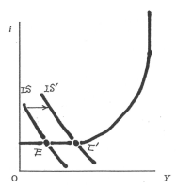
8．Depression and Fiscal Policy
不況と財政政策
①Positive Fiscal Policy
Increase in government expenditure G
⇒IS curve shifts a right side to IS’
⇒ Though interest rate drops to the bottom,
income Y increases and prices P remain unchanged
⇒ Effective Demand Policy by public finance (public works) is effective
⇒ Effectiveness of Deficit Fiscal Policy …Keynesian policy
⇒ Deficit during depression must be cancelled out
by surplus during boom
①積極財政政策
財政支出Gの増大
⇒ＩＳ曲線が右方シフトＩＳ’へ
⇒利子率は下限に張り付いていて変化はないが、
所得Yは増え、物価Pはほぼ不変
⇒財政の有効需要政策
（公共事業など）の効果はある
⇒赤字財政政策の有効性…ケインズ政策
⇒不況時の財政赤字は好況時の財政黒字で
埋め合わす、赤字垂れ流しは否定
Depression and Fiscal Policy

Slide 17
8B. Depression and Fiscal Policy
不況と財政政策
②Tight Fiscal Policy
Decrease in government expenditure G
⇒IS curve shifts a left side to IS”
⇒ Though interest rate drops to the bottom,
income Y decreases and prices P falls more
⇒ Deflation Effect by public finance
②財政引き締め政策
財政支出Gの削減⇒ＩＳ曲線が左方シフトＩＳ”へ
⇒利子率は下限に張り付いていて変化はないが、
所得Yは減って、物価Pは 更に下落
⇒デフレ効果
Depression and Fiscal Policy

Slide 18
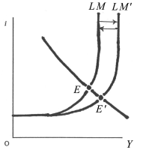
9. Under-employment and Monetary Policy
不完全雇用と金融政策
Ordinary under-employment is different from full employment or liquidity trap
LM curve is upward sloping, 0＜L'(i)＜∞,
money demand is interest elastic
Policy effects
⇒ Controversy between Keynesian and Monetarist
通常の不完全雇用では、完全雇用でも流動性の罠でもない
ＬＭ曲線は右上がり、0＜L‘(i)＜∞、
貨幣需要は利子弾力的、
政策効果は⇒ケインジアン対マネタリストの論争
Under-employment and Monetary Policy

Slide 19
9B. Under-employment and Monetary Policy
不完全雇用と金融政策
① Easy Money Policy
increases the money supply ⇒ LM curve shifts a right side to LM’
⇒ interest rate falls, income Y increases = the first-round effect
⇒ Keynesian make much of this effect
Monetarist make much of the second-round or ultimate effect
Increase in Y raises prices P and decreases real balance of money M/P
⇒ LM curve shifts a left side to LM, raises I, decreases Y
⇒ Monetarists think it has no policy effect
① 金融緩和政策
金融緩和で貨幣供給量増加
⇒ＬＭ曲線の右方シフトＬＭ’へ
⇒名目利子率は低下し、実質所得は増える、
一次的効果を重視するケインジアンは政策効果あり
二次的効果ないし究極的効果
所得増加で物価Pが上がり、実質貨幣残高M/Pが低下
⇒ＬＭ曲線の左方シフトでiを上げ、Yを減らす
⇒究極的効果を重視するマネタリストは政策効果なし
Under-employment and Monetary Policy

Slide 20
9C. Under-employment and Monetary Policy
不完全雇用と金融政策
① Tight Money Policy
decreases the money supply ⇒ LM curve shifts a left side to LM”
⇒ interest rate rises, income Y decreases = the first-round effect
⇒ Keynesian make much of this effect
Monetarist make much of the second-round or ultimate effect
Decrease in Y drops prices P and increases real balance of money M/P
⇒ LM curve shifts a right side to LM, drops I, increases Y
⇒ Monetarists think it has no policy effect
②金融引き締め政策
金融引き締めで貨幣供給量削減
⇒ＬＭ曲線の左方シフトＬＭ”へ
⇒名目利子率は上昇し、実質所得は減る
以上の一次的効果を重視する ケインジアンは政策効果あり
二次的効果ないし究極的効果
所得減少で物価Pが下がり、実質貨幣残高M/Pが増加
⇒ＬＭ曲線の右方シフトで名目利子率は下がり、実質所得は増える
⇒究極的効果を重視するマネタリストは政策効果なし

Slide 21
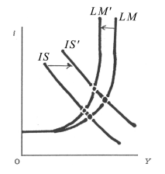
10. Under-employment and Fiscal Policy
不完全雇用と財政政策
①Positive Fiscal Policy
Increase in government expenditure G ⇒ IS curve shifts a right side to IS’
⇒ nominal interest rate I rises, income Y increases = the first-round effect
⇒ Keynesian make much of this effect
Monetarist make much of the second-round or ultimate effect
Increase in Y raises P, decreases real balance of money M/P
⇒LM curve shifts a left side to LM’, I rises, Y decreases
⇒ Monetarists think it has no policy effect
①積極財政政策
財政支出Gの増大⇒ＩＳ曲線が右方シフトＩＳ’へ
⇒名目利子率は上昇、実質所得は増える
一次的効果を重視するケインジアンは政策効果あり
マネタリストは二次的効果ないし究極的効果を重視
所得増加で物価Pが上がり、実質貨幣残高M/Pが低下
⇒ＬＭ曲線の左方シフトでiは上がり、Yは減る
⇒究極的効果を重視するマネタリストは政策効果なし
Under-employment and Fiscal Policy

Slide 22
10B. Under-employment and Fiscal Policy
不完全雇用と財政政策
②Tight Fiscal Policy
Decrease in government expenditure G ⇒IS curve shifts a left side to IS”
⇒ nominal interest rate i falls, income Y decreases = the first-round effect
⇒ Keynesian make much of this effect
Monetarist make much of the second-round or ultimate effect
Decrease in Y falls P, increases real balance of money M/P
⇒LM curve shifts a right side to LM, i falls, Y increases
⇒ Monetarists think it has no policy effect
②財政引き締め政策
財政支出Gの削減⇒ＩＳ曲線が左方シフトＩＳ”へ
⇒名目利子率は低下、実質所得は減る
一次的効果を重視するケインジアンは政策効果あり
二次的効果ないし究極的効果
所得減少で物価Pが下がり、実質貨幣残高M/Pが増加
⇒ＬＭ曲線の右方シフトで名目利子率は下がり、
実質所得は増える
⇒究極的効果を重視するマネタリストは政策効果なし
Under-employment and Fiscal Policy

