Slide 1
Money and Finance in Japan ：Theory and Practice 日本の金融論:理論と実際
Naotsugu HAYASHI 林 直嗣
Professor of Economics 経済学教授
Faculty of Business Administration 経営学部
Hosei University 法政大学

Slide 2
Introduction to Money and Finance in Japan course description
Theme or Objectives:
This course explains in plain terms the monetary and financial system, theory and policy in Japan. It will be easily understood even by students whose major is not economics.
http://www.i.hosei.ac.jp/hayashi
Course Description:
The main themes of this course are the following;
1. Basic concepts of our monetary economy:
financial markets, institutions, structure and system in Japan.
2. Basic microeconomic analyses of household finance and corporate finance in Japan.
3. Basic macroeconomic analyses of the Japanese monetary economy:
financial and goods markets, monetary and fiscal policies, inflation and deflation, etc..
4. Representative financial markets in Japan:
deposits and loan markets, stock markets, and bond markets.
5. Monetary policies in Japan.

Slide 3
Introduction to Money and Finance in Japan class schedule
Class 1 Course Introduction and Overview of Money and Finance
Class 2 Market Economy, Money and Finance: Discussion
Class 3 Financial Markets and Organizations
Class 4 Financial Structure and System : Discussion
Class 5 Japan's Central Bank; (a trip to) The Bank of Japan
Class 6 Household Finance : Discussion
Class 7 Corporate Finance : Discussion
Class 8 The Supply of and the Demand for Money;
Classical and Keynesian Theories : Discussion
Class 9 Equilibrium Analysis of Monetary and Fiscal Policies 1
Class 10 Equilibrium Analysis of Monetary and Fiscal Policies 2: Discussion
Class 11 Inflation, Deflation and Unemployment : Discussion
Class 12 Banking System, Deposits and Loan Markets
Class 13 Securities Companies, Stock and Bond Markets ;
(a trip to Tokyo Stock Exchange)
Class 14 Monetary and Financial Policies in Japan
Class 15 Final Examination; Review of the course

Slide 4
introduction to money and finance in Japan class schedule
Textbooks:
Reading materials and other handouts will be distributed in class.
http://www.i.hosei.ac.jp/~hayashi/sub3.htm
References:
・Financial English（金融英語の意味と読み方）, Nobukatsu NISHIMURA, et.al., Nikko Kikaku, 2003.4.(\2,500)
・Economic issues in contemporary Japan : money, banking, and foreign investment （英語で学ぶ日本の金融）, Naoyuki YOSHINO, et.al., Yuhikaku, 2000.4.(2,400)
Method of Evaluation:
Students will be evaluated on class attendance (15%),
short reports based on group discussions (35%),
and a final examination (50%).
Prerequisites:
A general knowledge of the economy and economics is desirable but not required.

Slide 5
０-1. What is a Qualification for Bachelor's Degree of University Education? 大学教育の学士力とは何か
What do you study at university ? 1st-2nd years⇒liberal arts, 3rd-4th years ⇒professional courses ⇒ Bachelor’s degree
University education has been inclined to intellectual training traditionally,
but needs to develop to a comprehensive education from now on.
Ministry of Education and Science
1. Intellectual Training = to train the brain, knowledge, understanding, judgment
(1) Theory = to understand, think and judge problems theoretically and rationally
(2) History and empirical analysis = to understand history and actual events deeply
(3) Policy = to make value judgment on problems
１．知育＝頭を鍛える、知識・理解・思考力
（１）理論的・合理的な理解力・思考力・判断力＝理論
（２）実際の事象の深い理解＝歴史と実証
(３) 政策的判断力＝政策
2. Physical Education = to train a healthy and strong body
2. 体育＝健康で強靱な体を鍛える

Slide 6
０-2. What is a Qualification for Bachelor's Degree of University Education? 大学教育の学士力とは何か
３． Education of Technical Skills
(1) Language communication skills…to learn languages
(2) Quantitative and mathematical skills…to understand quantitative data
(3) Information processing skills…to use computer and other IT or ICT tools
３．技育＝技能を学ぶ
（１）コミュニケーション・スキル＝語学
（２）数量的スキル＝数量データの把握
（３）情報処理能力＝コンピューターなどによる分析
４． Ethical Education…ethics, attitudes, responsibility
(1) compliance, responsibility, self-management ability ⇒ ability to adapt to society
(2) teamwork, leadership, creativity ⇒ ability to adapt to organizations
４．徳育＝倫理・態度・責任感を養う
（１）遵法精神・責任感・自己管理力＝社会適応力
（２）協調力・指導力・創造力＝組織適応力
５． Ability to think and solve problems comprehensively
５．総合的な思考力・解決力

Slide 7
１． What is science? 科学とは何か
Latin etymology scientia ( knowledge)
→ scienza (in Italy), science (in English & French), wetenschap (in Dutch) , Wissenschaft (in Germany), 科学 Kagaku (in Japanese & Chinese）
= certainly learned knowledge
語源はラテン語のScientia（知識）= 確実に知り得た知識
Pure science= mathematics, logic=science whose object is pure logic,
純粋科学＝純粋論理を対象とする科学＝数学、論理学
Natural science = science whose objects are natural phenomena= physics, chemistry,
biology, engineering, medicine, etc.
自然科学=自然現象を対象とする科学＝物理学、化学、生物学、工学、医学等
Social Science = science whose objects are social phenomena ＝economics,
business administration, political science, sociology, accounting, law, etc.
社会科学＝社会現象を対象とする科学＝経済学、経営学、政治学、社会学、
会計学、法学等
Humanities = science whose objects are human behaviors and their products
= psychology, geography, literature, cultural anthropology
人文科学＝人間の行動やその所産を対象とする科学＝心理学、地理学、文学、
文化人類学等

Slide 8
２． Scientific method 科学の方法
Science and Hypothesis written by Henri Poincare (1902, France)
Science assumes a theoretical hypothesis and tests or examines it by experiments. →Verify (verification) or falsify (falsification)
『科学と仮説』アンリ・ポアンカレ（1902）
科学（science）は理論仮説（hypothesis）を立て、
それを実験（experiment）などにより検証（test）する：
→立証(verify)、反証(falsify)
Religion does not assume a theoretical hypothesis but believes in God a priori.
Religion does not test a hypothesis by experiment but believes in a dogma by faith.
宗教は理論仮設を仮定しないで、神を先験的に信仰する
宗教は仮設を実験により検証しないで、信仰により教義を信じる。

Slide 9
３-1. Difference between economics and business administration 経済学と経営学の違い
Economics =
Microeconomics to analyze the economic activities of consumers, companies, governments and other economic agents individually
Macroeconomics to analyze the economy of a country as a whole or the economies of countries
経済学＝
ミクロ経済学は消費者、企業、政府などの経済主体の経済活動を個別に分析。
マクロ経済学はそれらがなす一国全体ないし諸国の経済活動を分析する。
Business administration = to analyze the business activities of profit organizations such as commercial firms and nonprofit organizations such as schools, hospitals and government
経営学＝企業などの営利組織や学校・病院・政府などの非営利組織の経営活動を分析する

Slide 10
３-2． Difference between economics and business administration 経済学と経営学の違い
Commerce = to analyze the processes from production of goods, distribution and sales to consumers
商学＝商品やサービスが生産、流通、販売の段階を経て消費者へ渡るまでの過程を分析する
Accounting = to analyze the measurement and management of revenue and expenditure of an economic subject, the difference between them ( = profit or loss statement), assets and liabilities (balance sheet), money flow table and other accounting information
会計学＝経済主体の収入と支出、その収支差（＝損益計算書）、資産と負債（貸借対照表）、資金収支計算書などの計数的情報の測定や管理を分析する

Slide 11
４. What is economy? 経済とは何か
Economics is defined as a science that inquires and analyzes economy
経済学＝経済を研究し分析する科学
Scarcity Definition by Lionel Robins (1932)
Economy is “human activities to get and utilize at any expense goods and
services that are relatively scarce in comparison with human desires for them"
ライオネル・ロビンズ（1932）による希少性定義
経済＝「人間の欲望と比較してその存在量が相対的に稀少な財貨やサービスを、何らかの犠牲を払って獲得・利用する活動」
Materialist definition by Alfred Marshall Economics is a science to study human behaviors that are related to material welfare
アルフレッド・マーシャルによる物質主義的定義
経済学は、人間の物質的厚生に関わる行動を研究する科学である

Slide 12
４-2. What is etymology of economy? 経済の語源は何か
Etymology in Chinese 経世済民 = 経済 = “to rule the society and save the people"
…in the sense of socio-economy
中国の語源では経世済民＝経済＝「世を治め民を救う」という社会経済的な意味
Etymology in Greek Oikos οικος (home, house) + Nomos νομος (law, norms)
= Oikonomia, Οικονομία (household management)… in the sense of private economy
ギリシャ語ではオイコス（家）＋ノモス（法、規範）
＝オイコノミア（家政、家計）
→ economia in Italy, economie in French and Dutch, Ökonomie in Germany,
economy in English = house, doing household
英語のeconomy＝家の資源を節約し、家計をやり繰りする
Around the late 18th century, Adam Smith→ political economy
In the 20th century → refined scientific definition
18世紀の後半アダム・スミスの頃→政治経済
20世紀に入って→科学的に純化された定義

Slide 13
５. Purposes of Money and finance 金融論の課題
Money and Finance = A branch of economics 経済学の一部門
Monetary Economics, Financial Economics at graduate school
Monetary theory 金融理論
① to analyze the monetary economy from the viewpoint of money and to clarify the role of finance in the economy
貨幣（カネ）の流れに沿って貨幣経済を分析し、
貨幣や金融が果たす役割を明確化
② to investigate how money and finance relate with and affect the real economy to each other.
貨幣の産業的流通と財（モノ）の流れからなる実物経済との関連を解明
Monetary policy 金融政策
③ to inquire how we can improve the real economy by conducting monetary policy
貨幣や金融の政策的コントロールを通じて、実物経済の成績をあげることを研究

Slide 14
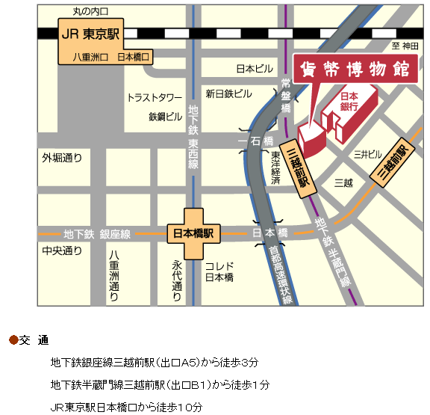
６. Currency Museum: the Bank of Japan 貨幣博物館：日本銀行
3 minutes from Mitsukoshimae of Subway Ginza Line
1 minute from Mitsukoshimae of Subway Hanzomon Line
5 minutes from Nihonbashi of Subway Tozai Line
10 minutes from Tokyo of JR

Slide 15
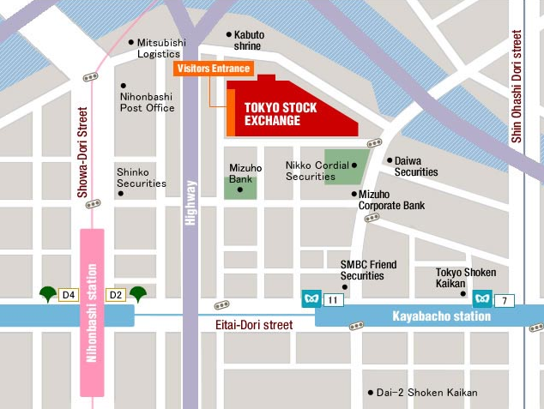
7. Tokyo Stock Exchange 東京証券取引所
Kayabacho station (Tozai line, exit 11) 5 minutes' walk
Kayabacho station (Hibiya line, exit 7) 7 minutes' walk
Nihombashi station (Toei Asakusa line, exit D2 ) 5 minutes' walk
2-1 Nihombashi Kabutocho, Chuo-ku Tokyo 103‐8224 Tel: 81-3-3665-1881 (direct) Fax: 81-3-3662-0547
Let’s meet in front of the
Visitors Entrance at 10:30
on July 5.

Slide 16
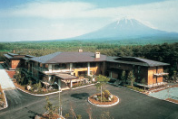
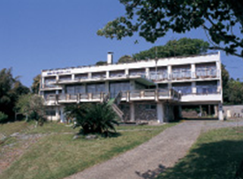
8. Fuji seminar houses: MIURA SEMINAR HOUSE 富士セミナーハウス: 三浦セミナーハウス
Fuji Seminar House is located near Mount Fuji，1,100m above sea level besides Aokigahara, which is famous for the sea of trees.
Address = 8532-272, Jiragonno, Narusawa-mura, MinamiTsuru, Yamanashi Prefecture Tel.0555-85-2773
Transportation = about 2 hours by Express Bus from Shinjuku station
to Kawaguchiko, \1,700
Hot Spring =Yurari 16 kinds of hot springs \1,000
http://www.fuji-yurari.jp/
Miura Seminar House is located near Miura Seashore.
Address = 1002-7, Kamimiyata, Minamishimoura-machi,
Miura-city, Kangawa Prefecture Tel.0468-88-0034
Transportation = about 1.5 hours by Keihin Kyuko Line
from Shinagawa to Miura Kaigan, \830
Fees 3,500 yen = 37 US dollars
Accommodation fee = 2,000 yen
Breakfast = 500 yen
Dinner = 1,000 yen

